Slide 1
COLLEGE MANAGEMENT SYSTEM

Slide 2
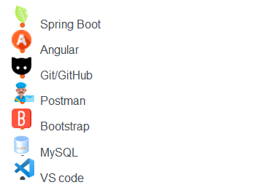
Technologies Utilized

Slide 3
Abstract
College Management System is a web application empowers college administrators to manage student data with a user-friendly interface.
Using Spring Boot, MySQL, and Angular, the system offers CRUD (Create, Read, Update, Delete) functionalities for student records.
Administrators can seamlessly add new students, view existing information in a clear tabular format, modify details as needed, and remove out-dated entries.
Additionally, the system facilitates data export in Excel format for further analysis and record-keeping.

Slide 4
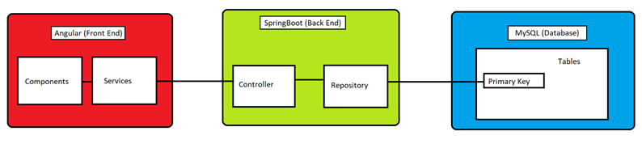
Architecture Diagram

Slide 5
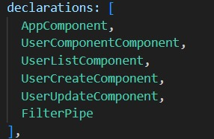
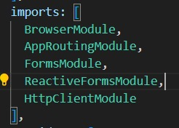
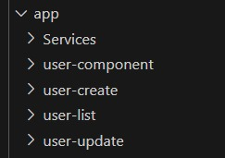
Angular components, imports, declarations.

Slide 6
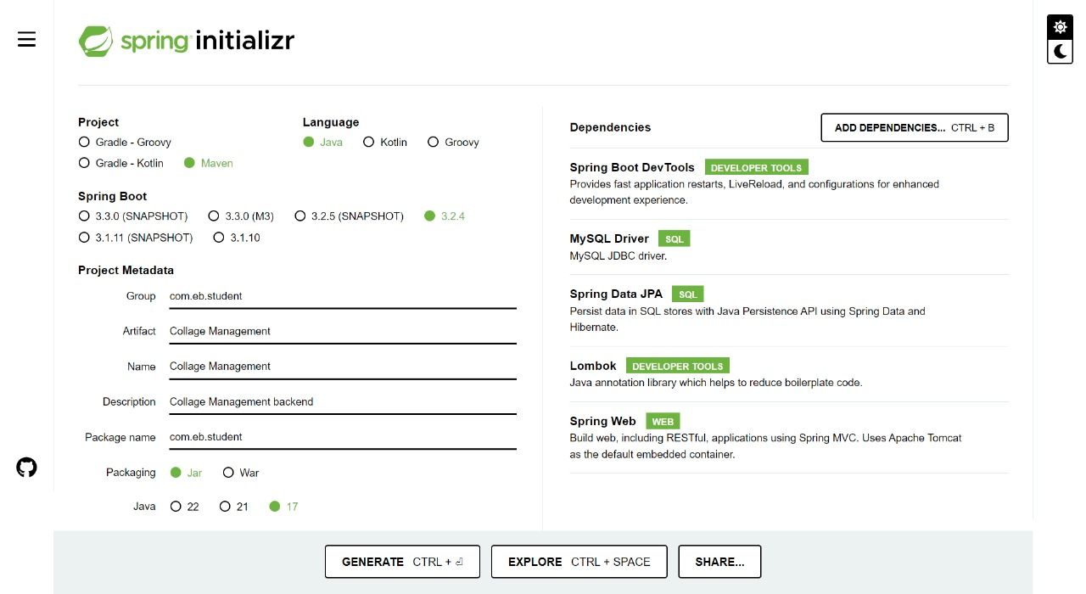
SPRING BOOT INITIALIZER

Slide 7
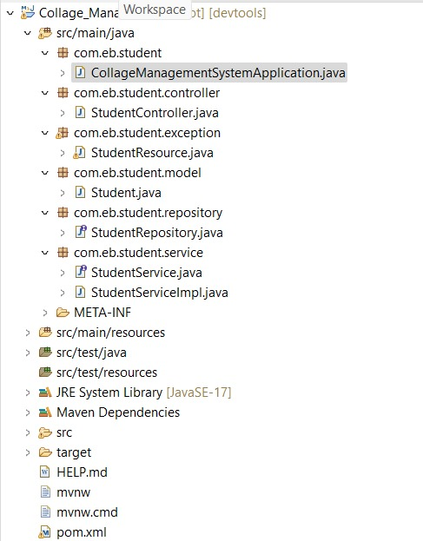
Java Backend Class Hierarchy

Slide 8
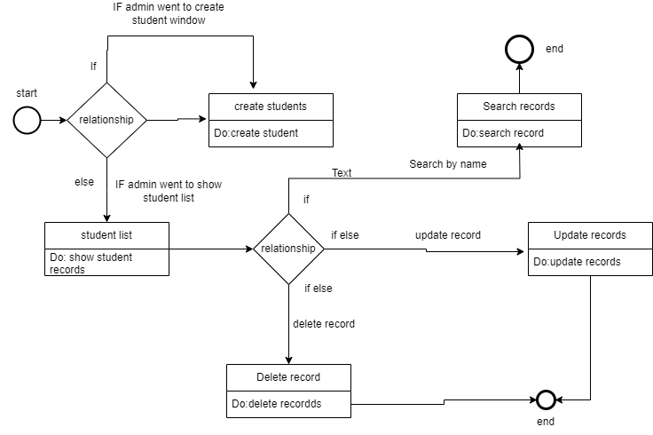
STATE Diagram for MySQL

Slide 9
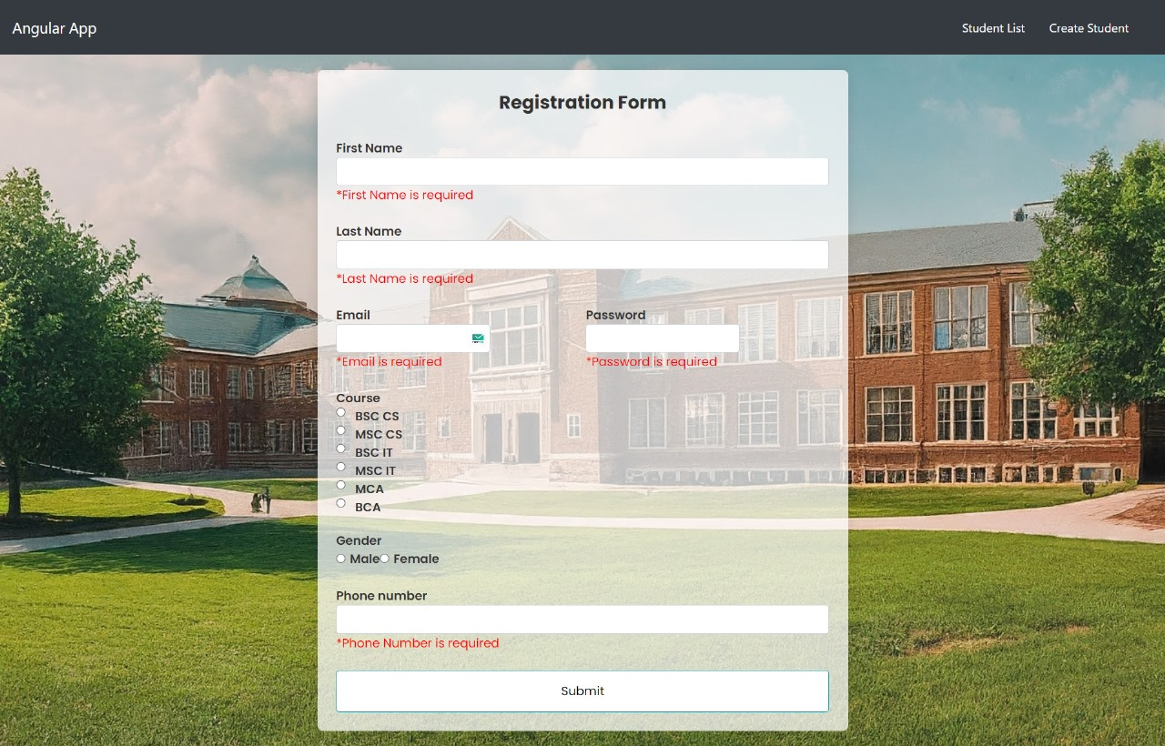
Registration Page

Slide 10
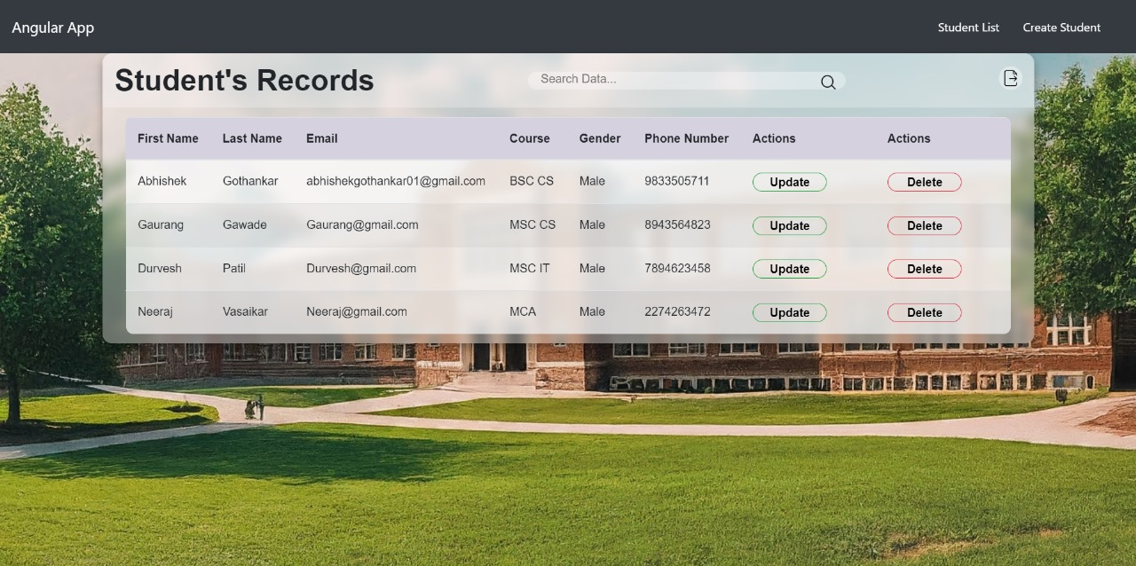
Record Page

Slide 11

Update Page

Slide 12

Exporting Student Records

Slide 13
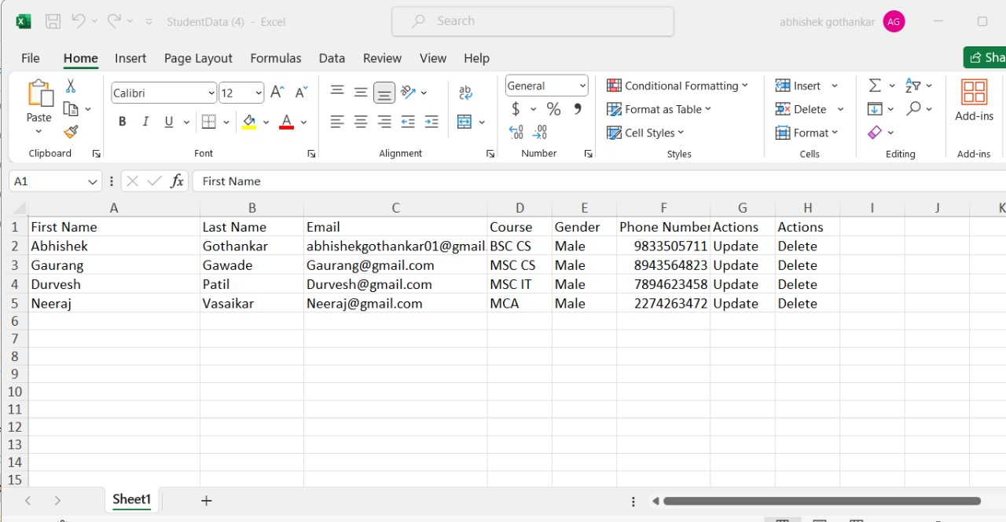
Excel Output

Slide 14
Conclusion
This college management system makes it easy for college staff to add new students, update information, and see all student records in one place.
No more piles of paper! You can even export the data to Excel for further use.
This system is a great way to keep track of students and make college life smoother for everyone.

Slide 15
THANK YOU !

